Slide 1
Grouping Attribute Recognition for Pedestrian with Joint Recurrent Learning
IJCAI 2018

Slide 2
Motivation
Grouping to mine the intra-group attribute correlations including sematic dependency and spatial neighborhood
Body Region Proposal to get spatial attention for the local attribute groups to focus on
Sequential grouping attribute prediction with LSTM to mine the inter-group correlations

Slide 3
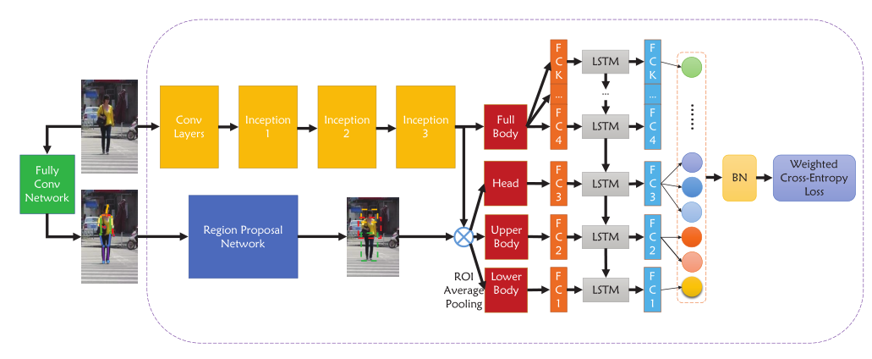
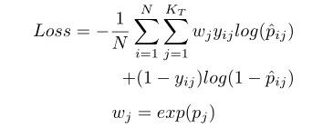
Framework

Slide 4
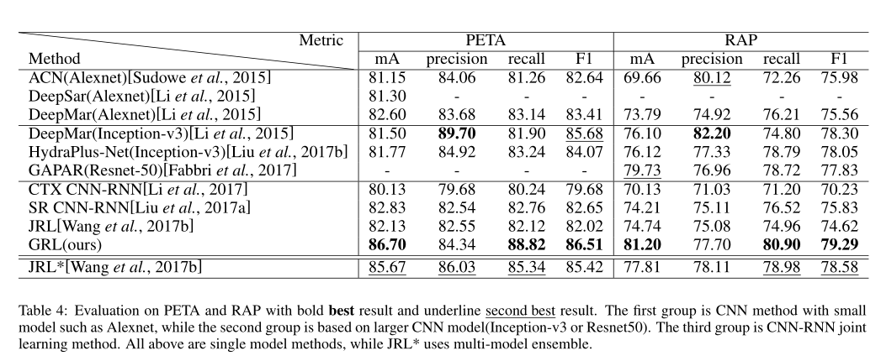
Experiment

Slide 5
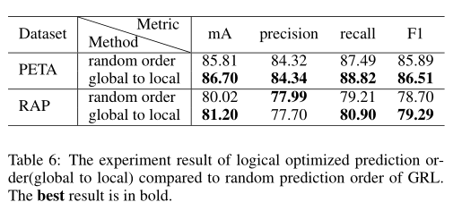
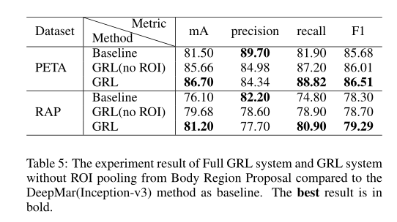
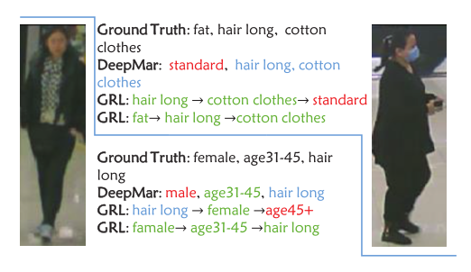
Effect of Body Region Proposal and LSTM

Slide 6
Thanks!

